Slide 1

Presentation by
Elderly Population
Falls-Mobility-Frailty
Part One/Course 1
Dr Rob Grieve

Slide 2
Aims/Objectives/Content
Brief overview of pathophysiology related to elderly population-Set the Scene
To gain a knowledge and understanding of the benefits of exercise and physical activity in the elderly population.
What is the effect of leading a physically active lifestyle can have on health, specifically related to the elderly.
Evaluate the current evidence available to support exercise in the elderly population, related to Falls/Mobility/Frailty.
To demonstrate evidence based practice in clinical exercise.

Slide 3
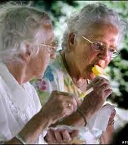
What is Ageing? (Recap from Foundations Exercise Prescription)
May be defined as:
A multidimensional process of physical, psychological, and social change
Producing observable change in structure and function
Being more susceptible to environmental stress and disease
Notes:
What do you think is old?
Environmental stresses.
Immune system compromise – can this be boosted with activity? Use studies to support.

Slide 4
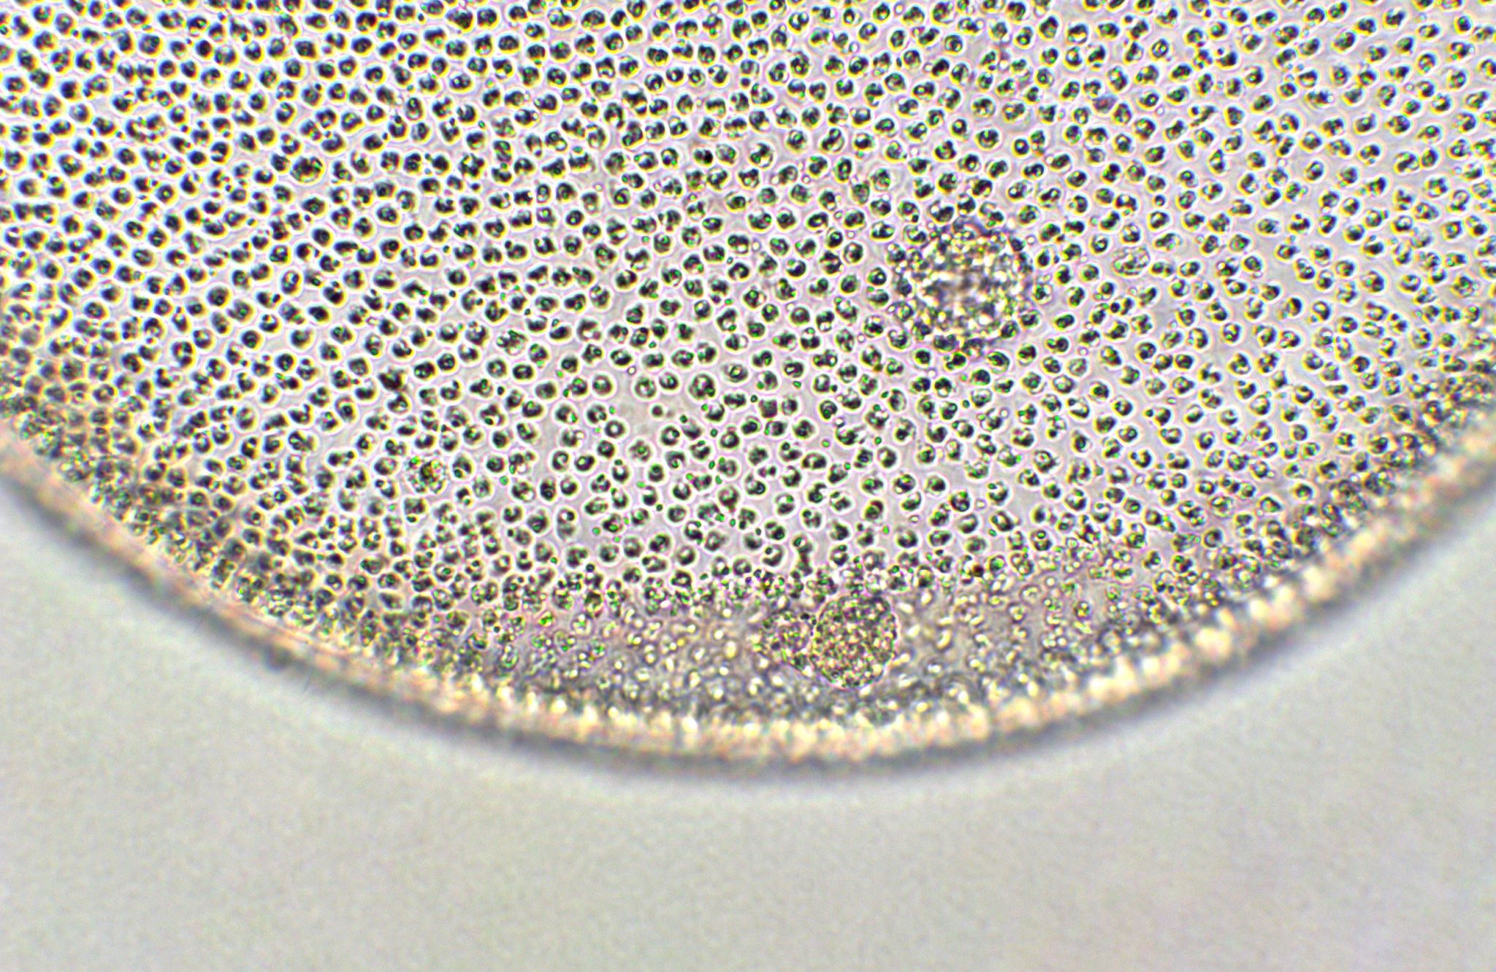
Physiology of Aging (Recap from Foundations Exercise Prescription)
Notes:
Cells replicate and the telomeres degrade, shortening over time altering the chromosomes (DNA).

Slide 5
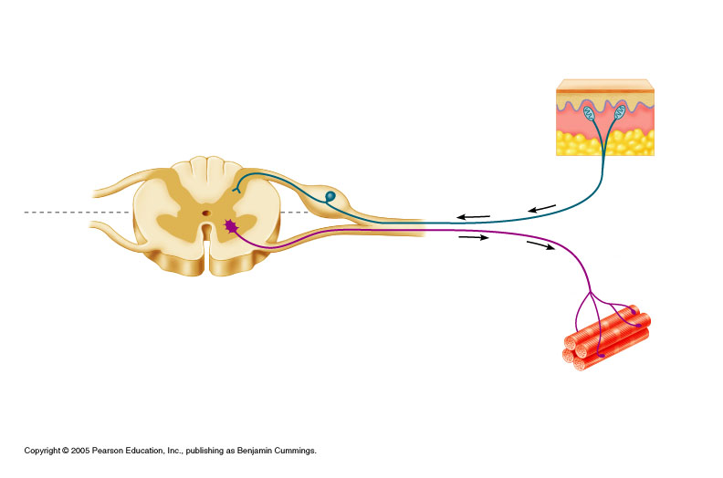
Effects of Ageing – Neural system
(Recap from Foundations Exercise Prescription)
Neuronal depletion
Reduced conduction speeds
Diminished postural stability
Reduction in Joint Position Sense
Decreased sensitivity of muscle spindles
Reduced numbers of articular receptors
Notes:
Proprioception. Reaction speeds. Can we improve these with training?

Slide 6
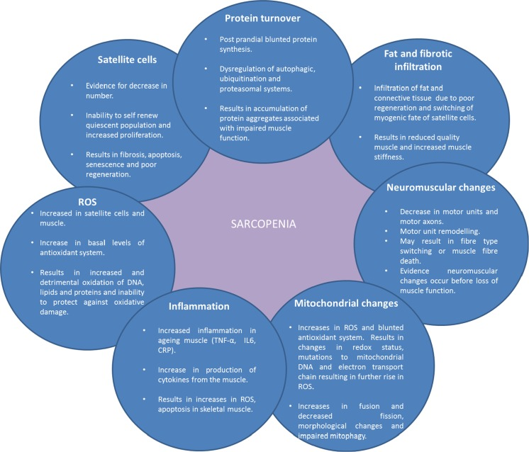
Sarcopenia (Recap from Foundations Exercise Prescription
Notes:
Sarcopenia – loss of muscle mass. Gradual process from 30s. Increases pace after 65.
Satellite cells - Non-specific cells that can adapt to become specialised. REDUCE IN NUMBER.
Protein turnover - Less protein. Harder to repair and build muscle.
Fat and fibrotic infiltration - into muscle.
Neuromuscular changes - Fibre type shift to slower fibre type.
Mitochondrial changes
Inflammation – INCREASES.
Reactive Oxygen Species – adding an electron to O2 molecule during mitochondrial respiration. DECREASES ability to protect against oxidative damage.

Slide 7
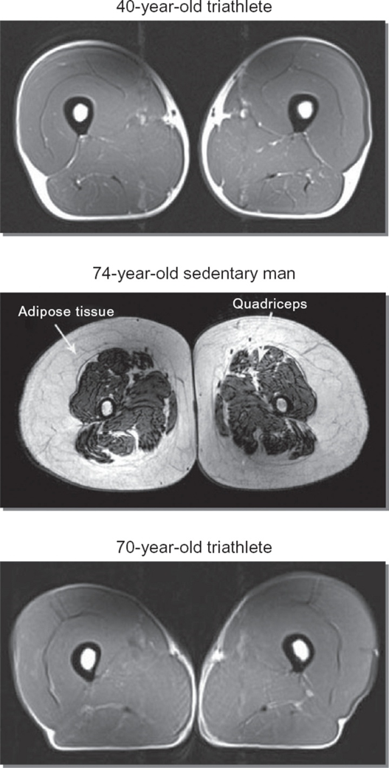
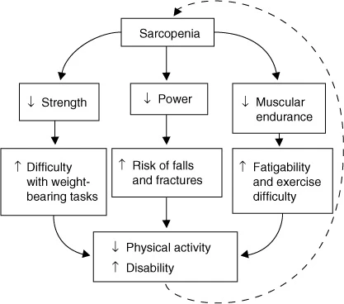
Muscle Mass (Recap from Foundations Exercise Prescription
Older adults prone to muscle atrophy (+/- 1% / year)
Particularly fast twitch (Type IIa & IIx)
Will see a reduction in myofiber number
Increased infiltration of fat
Lavin et al., 2019
Notes:
Compare triathletes to inactive 70-year-old male.
Reduction in strength and power. Reduced ability to respond to threats to balance. Reduced endurance. Higher risk of fall # and disability.

Slide 8
Neuromuscular performance (Recap from Foundations Exercise Prescription
Muscle strength: 2-4% decrease
Muscle power 8-9% decrease
Strong predictor of physical impairment
Older Adults have 30-40% less motor units compared with young adults.
25 – 35% increase in 1RM in 8-12 weeks with RT at 70% of 1RM
Neural adaptations the driving force
Lavin et al., 2019
Notes:
Muscle power more important predictor for falls than pure strength.
Resistance training. Neural adaptation like in prepubescent adolescents and children.

Slide 9
Strength v Power AIF | Australian Institute of Fitness
Strength is the ability of your muscles to generate force against resistance. Measure of how much weight you can move—think of a one-rep max (1RM) deadlift, squat, or bench press. Is a foundational physical quality that supports almost every athletic endeavor, sprinting-swimming.
Types of Strength
Maximal Strength: The greatest amount of force you can produce in a single voluntary contraction. Relative Strength: Strength in relation to your body weight. Endurance Strength: The ability to sustain muscular contractions over time.
Strength is often developed through high-load, low-repetition resistance training, focusing on compound movements and progressive overload.
Power is the ability to generate force quickly. Described as force × velocity, meaning both strength and speed matter. Power is what enables a sprinter to explode off the blocks or a basketball player to soar for a dunk. It’s not just about how much force you produce, but how fast.
Types of Power
Explosive Power: Sudden, high-intensity movements like jumps, throws, or sprints.
Reactive Power: Your ability to quickly respond and rebound, such as in plyometric drills.
Speed Strength: Force production with an emphasis on movement velocity.
Training for power often involves lighter loads than strength training, but performed with maximum speed and intent—think Olympic lifts, plyometrics, and sprinting.

Slide 10
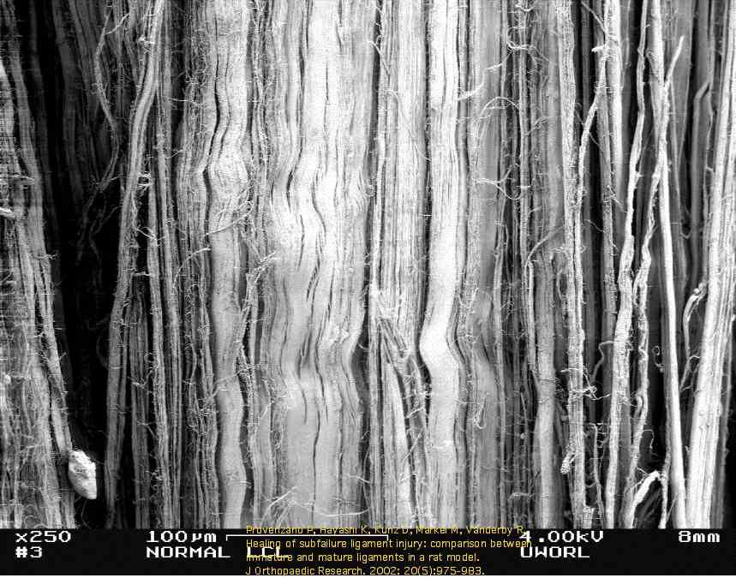
Connective Tissue Changes (Recap from Foundations Exercise Prescription
Changes in collagen tensile strength
Weakening of insertions
Increased ratio of connective tissue: muscle
Notes:
Non-contractile. Loss of elastin so less flexible. More prone to injury.
Weakening of insertion points (conditions more prevalent in mid to older age – tennis elbow, TA rupture or tendonopathy.

Slide 11
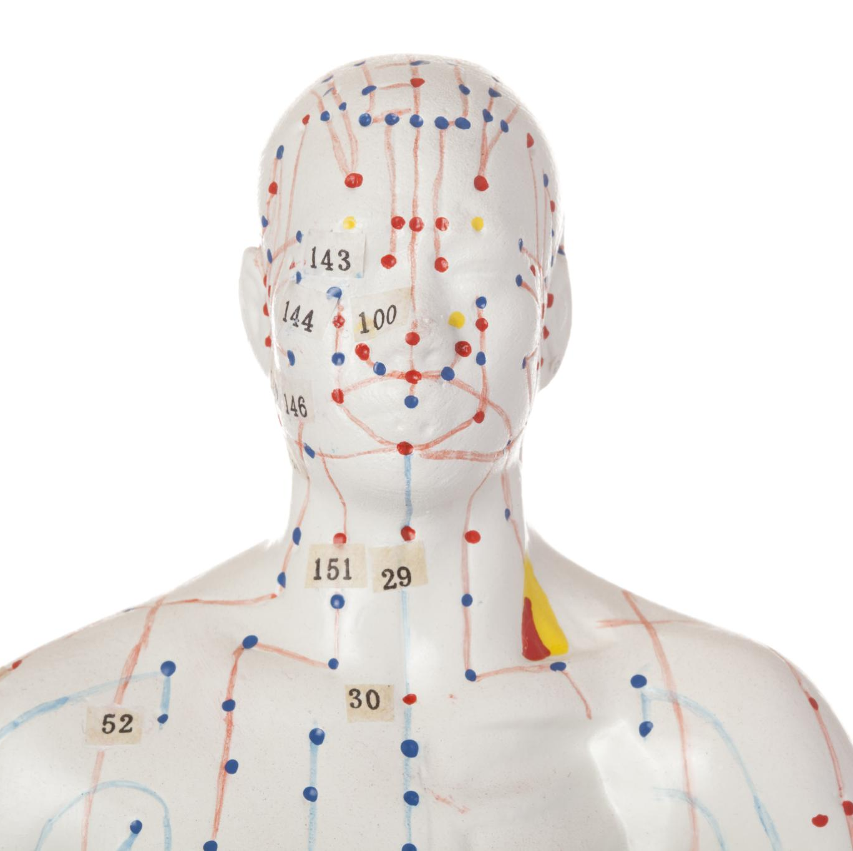
Pathophysiology related to Frailty and Falls
Musculoskeletal Deterioration
Aging leads to sarcopenia and osteoporosis, reducing muscle mass, strength, and bone density, increasing fall risk.
Larsson et al., 2019; Greco EA, Pietschmann P, Migliaccio 2019; Yang et al., 2025
Neurological and Sensory Decline
Peripheral neuropathy and CNS aging impair balance, while sensory deficits reduce spatial orientation, increasing falls (Woo, 2019)
Cardiovascular Dysregulation
Age-related physiological changes reduce baroreflex sensitivity, weakening the ability to stabilize blood pressure on standing. This impaired response leads to orthostatic hypotension and associated symptoms such as dizziness (Dani et al., 2022
Inflammation and Endocrine Changes (related to Sarcopenia)
Chronic inflammatory sarcopenia (Blajovan et al., 2025) and hormonal decline (Chen and Wue, 2025) exacerbate muscle loss and frailty progression, increasing vulnerability to falls.
Notes:
Aging is accompanied by multisystem physiological decline that significantly impairs the body's ability to maintain homeostasis, thereby increasing vulnerability to frailty and falls. One of the most prominent contributors is musculoskeletal deterioration, particularly sarcopenia, which involves a progressive reduction in muscle mass, strength, and function due to diminished protein synthesis, hormonal declines such as lowered IGF-1 and testosterone, and degeneration of motor units. This loss of muscle power critically reduces gait stability and reaction time, both essential for preventing falls. Additionally, osteoporosis further compromises structural integrity by decreasing bone mineral density, heightening fracture risk when falls occur. Neurological changes play a substantial role as well; peripheral neuropathy reduces proprioceptive feedback and nerve conduction velocity, while central nervous system aging diminishes cognitive processing speed, executive function, and dual-tasking ability, all of which are vital in maintaining balance. Sensory declines—such as impaired visual acuity, reduced contrast sensitivity, and vestibular dysfunction—further hinder spatial orientation and increase fall susceptibility. Cardiovascular dysregulation, particularly orthostatic hypotension stemming from impaired baroreceptor reflexes and autonomic dysfunction, contributes to episodes of dizziness or syncope leading to sudden falls. Chronic systemic inflammation, known as inflammaging, characterized by elevated inflammatory markers like IL-6 and TNF-α, promotes catabolic processes that exacerbate muscle loss and functional decline. Endocrine alterations, including decreased levels of sex hormones, vitamin D, and growth factors, also impair musculoskeletal and neuromuscular health, reinforcing frailty progression. Collectively, these interconnected physiological changes drive the frailty–fall cycle: declining physiological reserves reduce resilience to external stressors, making even minor perturbations capable of triggering falls. This cycle becomes self-perpetuating, as each fall can lead to injury, immobility, and further deconditioning, thereby amplifying frailty and increasing future fall risk.

Slide 12
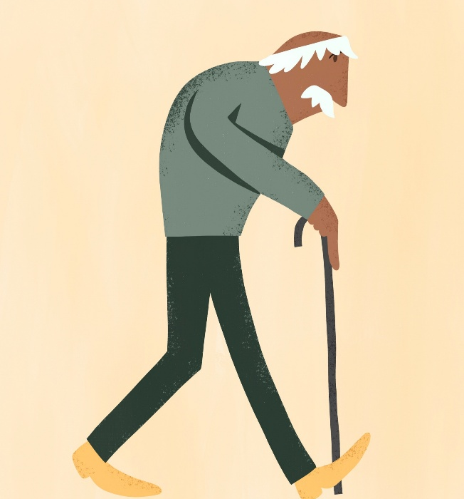
Falls
Falls are common and serious concern among older adults, with one in three adults aged ≥ 65 years falling at least once a year (Phelan and Ritchey, 2018). One in four individuals >65 years falls in the United States every year (ACSM, 2026).
In the US, falls are the leading cause of injury-related death among older adults, accounting for 46.2% (Centres for Disease Control and Prevention, 2024).
Falls are also linked to function decline, loss of independence, and increased mortality rates Terosso, et al., 2014, leading to a substantial economic burden. Identifying modifiable risk factors is crucial for reducing the incidence of falls among older adults (Yang et al., 2025)

Slide 13

Sarcopenia, characterized by decreased muscle mass and function, is considered an important modifiable risk factor for falls, with a global prevalence ranging from 3.3% to 36% (Zang et al.,2020; Veronese et al., 2021, Yang et al., 2025)

Slide 14
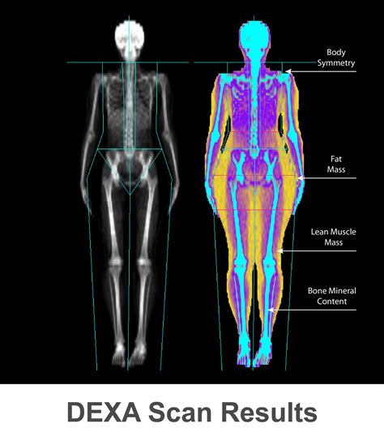
Appendicular lean mass (ALM)
The musculature of the arms and legs, appendicular lean mass (ALM), accounts for ≥75% of skeletal muscle in the body and is required for ambulatory activity and physical functioning (Gallagher et al., 1985).
Older adults lose approximately 0.1 kg (0.5%) of ALM annually after the age of 40–50 years (Gallagher et al., 1985; Auyeung et al., 2014; Kitamura et al., 2014)
The progressive loss of ALM may be a key element in the development and progression of frailty (Idoate et al., 2014).
Frailty is a syndrome of poor global health, highly prevalent among older adults that includes unintentional weight loss, impaired physical function, weakness, exhaustion, and low levels of physical activity (Fried et al, 2001).
Prefrail and frail older adults are prone to experience disability, falls, hospitalization, and death (Fried et al, 2001)
DXA Scan

Slide 15
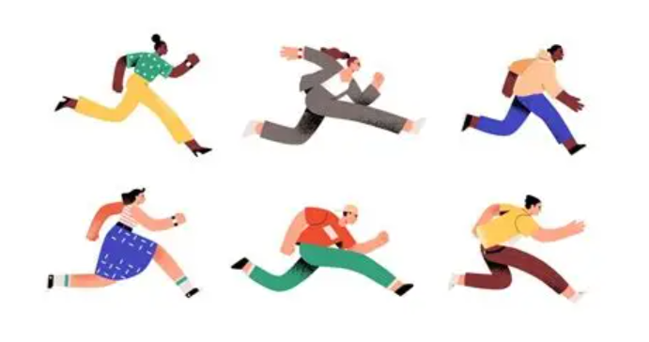
Walking Speed (We will review in Physiological and Performance Testing Session)
Walking speed not only reflects walking ability but is also closely related to overall health, muscle strength, balance, neural control, and cognitive function. A slower walking speed may be the result of a combination of multiple physiological, neurological, and environmental factors, all of which are associated with an increased risk of falls. Therefore, monitoring and improving gait speed is critical to preventing falls in older adults (Yang et al., 2025)
Task: Could you review walking speed in aerobic
exercise programme?

Slide 16
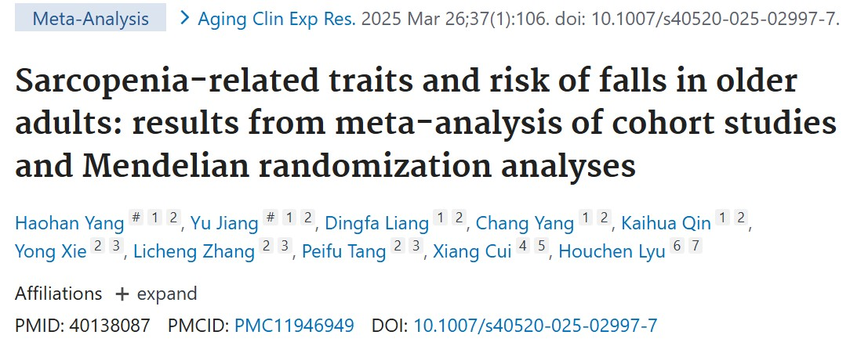
Meta-analysis included 34 cohort studies.
33% reduced fall risk with each unit increase in walking speed.
2% decrease with each unit increase in hand strength However, no significant effect on falls with appendicular lean mass.
Only walking speed was causally associated with falls. Hand strength and appendicular lean mass showed no statistically significant causal effect on falls.
Walking speed therefore important in exercise testing and prescription.

Slide 17
Overall benefits of PA in Older Adults
Slowing age related changes
Optimizing body composition
Managing chronic diseases
Reducing risk of physical disability
Increasing longevity
Promoting psychological & cognitive wellbeing
Adapted from Liguori, 2022
Notes:
Lower fat levels. Maintain muscle mass. ADL engagement. Social interaction. Improved mood. Increased longevity – years of healthy life.
WHO guidelines 2020.

Slide 18
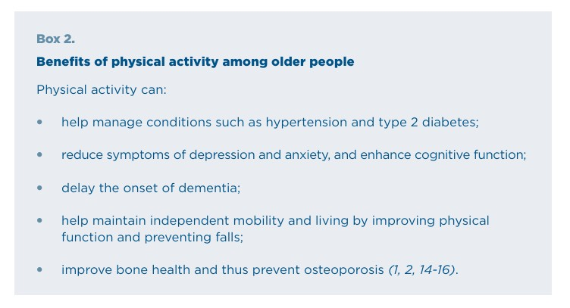
Benefits of PA for Elderly People
WHO- Promoting physical activity for older people: a toolkit for action ISBN 978-92-4-007664-8 (electronic version)-2023

Slide 19
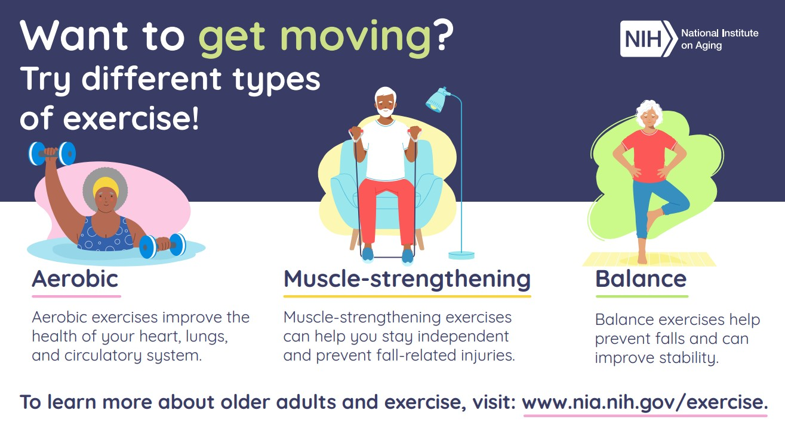

Slide 20
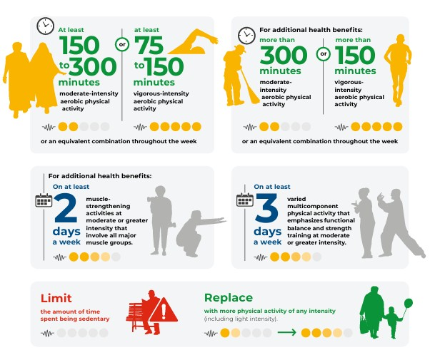
WHO guidelines physical activity & sedentary behaviour (2023)

Slide 21
Benefits of PA for Elderly population
Regular physical activity can help older people maintain and improve their mental health and cognitive ability, delay the onset of dementia, and reduce symptoms of depression and anxiety (WHO, 2019;2020;Livingston et al, 2017)
It can also improve other functional abilities, including physical function and balance, thereby preventing falls and fall-related injuries (WHO, 2019;2020;Livingston et al, 2017).
Being physically active also helps to prevent heart disease and cancer, and to prevent and manage chronic conditions such as type-2 diabetes and hypertension. Recent estimates show that being physically active could prevent 500 million new cases of noncommunicable diseases (NCDs) and mental health conditions, including depression and dementia (Santos, et al 2023)
Just as importantly, physical activity brings social benefits, as being active offers the chance to build relationships and strengthen networks around an older person, enabling their continued contribution to society (WHO, 2023).
TASK: CAN YOU THINK OF ANY OTHER BENEFITS OF PA FOR ELDERLY PEOPLE? What about social benefits, mental health?

Slide 22
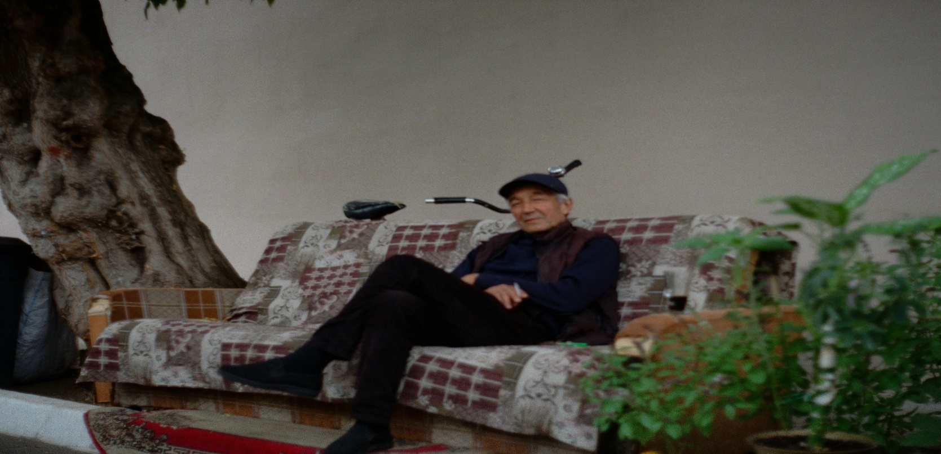
Photo by Pavel Boltov on Unsplash
HOWEVER, around a quarter of all adults – and over 40% of people aged over 70 years (38% of men and 48% of women) – do not do enough physical activity to maintain and improve their physical and mental health (Bauman et al, 2016, WHO 2023).

Slide 23
Exercise prescription and elderly population common medical conditions.
Mobility, Frailty and Falls Risk
Sarcopenia and Bone Health osteoporosis
Mental Health-Age‑Related Cognitive Decline
NCDs/Chronic Disease cardiovascular disease, respiratory, diabetes.

Slide 24
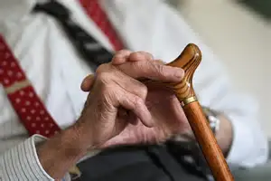
Defining Physical Frailty
In defining physical frailty usually includes measurements of handgrip strength and gait speed. Consistently, physical performance measures, as gait speed, Timed Up-and-Go (TUG) test, and the Short Physical Performance Battery (SPPB) are useful instruments for the screening of frailty in the general population (Lee, Lee and Yang, 2020).
We will cover in Physiological/Physical Performance Testing Session.

Slide 25

Exercise and fraility
Several studies that have focused on combined interventions of nutrition and exercise to improve physical performance in pre-frail and frail older adults have shown promising results, with exercise appearing to be an essential component for the maintenance of independence in people with frailty (Kidd et al., 2019)
Combining physical activity, nutrition, and social support and assessing which components are most effective in reducing frailty might add to the understanding of whether and how frailty, physical functioning, and quality of life in older people can be impacted (Drewnowski and Evans, 2001)

Slide 26
Otago Exercise Programme (OEP)
Previous research has shown that poor strength and balance are risk factors for falls and injuries in older people and that these exercise types/components be improved by specific exercises (Tinetti et al., 1988, Campbell et al.,1989)
The OEP a set of leg muscle strengthening and balance retraining exercises designed specifically to prevent falls. It is individually prescribed and delivered at home by a research physiotherapist and trained nurses from a community home health service and primary healthcare practices. Secondary outcome it was found to reduce MSK and hip/knee arthritic pain.
*Four RCTs assessed whether the OEP reduced falls and injuries in community-living older people. 1016 women and men aged 65 to 97 were recruited, with falls and injuries reduced by 35%.
*Campbell et al.,1997;1999;Robertson et al., 2001; Robertson et al., 2001.

Slide 27
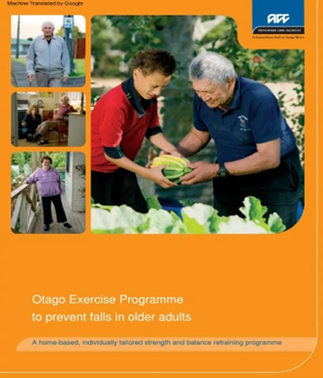
Otago Exercise Programme (OEP)
The OEP starts with the first home visit where the physiotherapist will discuss general information and goals of the program with the patient and collect relevant clinical history information. Additionally, an intake assessment of balance and strength is performed, with the 30 Seconds Sit To Stand Test and The 4-Stage Balance Test Campbell et al, 2003).
Additional home visits and follow-up phone calls are performed during the program by the physiotherapist with the aim of encouraging adherence(Sherrington et al, 2018)
Exercise programmes are varied(NOT just traditional PARS/ERS)

Slide 28

OEP Programme Outline
(How does this relate to ACSM Exercise Prescription/FITT-C=VP
Based on the results of the initial assessment, an exercise and a walking program prescribed by the therapist.
The OEP comprises 5 strengthening exercises and 12 balance exercises (Campbell and Robertson, 2003)
Participants are instructed to perform the exercises three times (30 mins per session) a week (Gardner et al, 2001). Depending on the individual’s strength and mobility, the exercises can be progressed, by increasing the amount of repetitions or weight (ankle cuffs with weight can be used and adjusted during the program).
Participants are also provided with a walking program, aiming to include a 2x week 30 minutes walking session (can be broken into smaller periods e.g. three ten-minute blocks)(Gardner et al, 2001).
To help them adhere to the programme, participants record the days they complete the programme and the instructor telephones them each month between home visits. Follow-up home visits are recommended every six months.
We will discuss OEP further in the planning of exercise programmes sessions for special populations.

Slide 29

Summary of Research Evidence for OEP
Trial 1: Campbell AJ et al. BMJ 1997;315:1065-1069;
Campbell AJ et al. Age Ageing 1999;28:513-518.
Trial 2: Campbell AJ et al. J Am Geriatr Soc 1999;47:850-853.
Trial 3: Robertson MC et al. BMJ 2001;322: 697-701.
Trial 4: Robertson MC et al. BMJ 2001;322:701-704.
Process and impact evaluation:
Gardner MM et al. Prev Med 2002;34:546-553.
Meta-analysis of the four trials:
Robertson MC et al. J Am Geriatr Soc 2002;50:905-911.
Other:
How to do it”: Gardner MM et al. Age Ageing 2001;30:77-83.
Summary of the research

Slide 30
Main Research Findings
Meta-analysis of the four trials: Robertson et al., (2002) J Am Geriatr Soc ;50:905-911.
Overall, the effect of the exercise programme was a 35%reduction in the number of falls and a 35%reduction in the number of fall related injuries.
Combining the results from the four trials highlighted the fact that the programme prevented the most falls and injuries in those aged 80 years who had fallen in the previous year.
Two simple (Baseline Assessments) physical assessments (the chair stand test and four-test balance scale) showed improved strength and balance in exercise group participants.
Participants maintained confidence in being able to carry out ADL without falling. Important because people afraid of falling may become physically inactive, which will result in further declines in muscle strength and balance.
There were very few adverse events in the trials due to the exercise programme.
The OEP has not been tested in a context other than the home-based community setting.

Slide 31
falls management exercise programme (FaME)
FaME is delivered in weekly 1-hour group exercise classes (approximately 6
participants per class) plus directed home exercise to ensure effective dosage
and appropriate functional improvements. Elastic resistance bands, dumbbells
and small items of equipment are used throughout the programme.
The evidenced-based elements of the programme include:
Functional leg muscle strengthening and balance retraining that progress in difficulty
Functional progressive trunk and arm muscle strengthening
Bone loading targeted prime fracture sites
Endurance/cardiovascular training (including walking) and flexibility training
Functional floor skills and skills to rise from floor (preventing long lies)
https://fametoolkit.org.uk/index/1757330514790x755738355278020600?section=introduction-to-the-toolkit

Slide 32
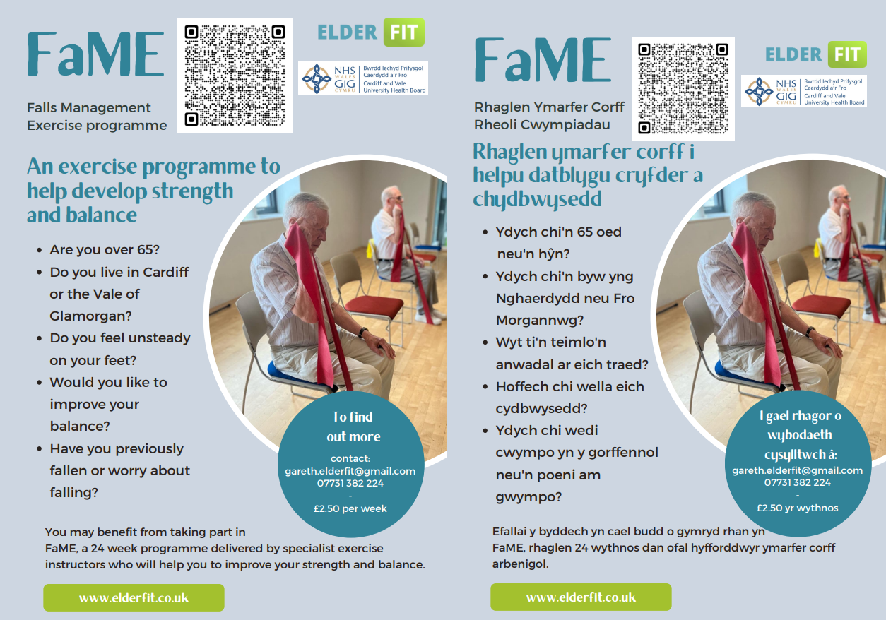
Falls Management Exercise programme (FaME)
Another example of an exercise programmes NOT traditional PARS/ERS

Slide 33
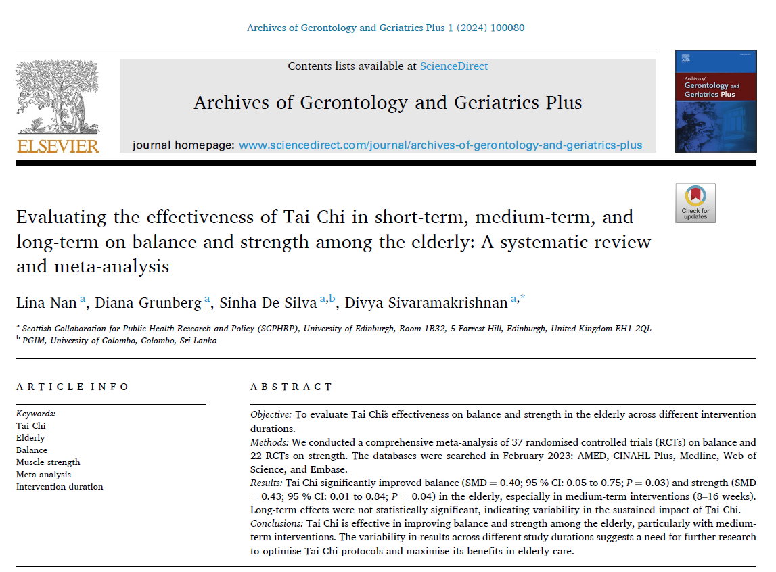
Tai Chi another exercise option, effective on balance and strength in elderly population.

Slide 34

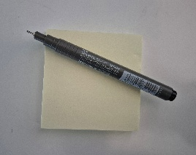
Group Activity
Any takeaways from this session?
Has it helped you in your understanding of Elderly population/Frailty/Falls in respect of exercise prescription?
Work in pairs, put ideas on a post-it or interactive board and then share with the group.

Slide 35

Any Questions

Slide 36
PART TWO (Course 2)
AIM:
To apply the principles of planning and designing an exercise progamme for special populations.

Slide 37
References
Adam, Claire E., et al. (2021) The Association Between Gait Speed and Falls in Community Dwelling Older Adults With and Without Mild
Cognitive Impairment. International Journal of Environmental Research and Public Health, 18, 3712.
Auyeung TW, Lee SWJ, Leung J, Kwok T, Woo J. (2014) Age-associated decline of muscle mass, grip strength and gait speed: A 4-year longitudinal
study of 3018 community-dwelling older Chinese. Geriatrics & gerontology international. 2014;14:76–84.
Bull FC, Buchner DM, Fiatarone Singh MA. (2016) Updating the evidence for physical activity: Summative reviews of the
epidemiological evidence, prevalence, and interventions to promote "active ageing". Gerontologist. 56 Suppl 2:S268–80
Bullo V, Gobbo S, Vendramin B, et al. Nordic walking can be incorporated in the exercise prescription to increase aerobic capacity, strength, and quality of life for elderly: a systematic review and meta-analysis. Rejuvenation Res. 2018;21(2):141-161.
Blajovan, M.-D.; Abu-Awwad, S.-A.; Tomescu, M.-C.; Tudoran, C.; Gurgus, D.; Dinu, A.; Abu-Awwad, A (2025) The Role of Inflammatory Sarcopenia
in Increasing Fall Risk in Older Adults: Exploring the Impact on Mobility-Impaired and Immunocompromised Patients. Geriatrics 10, 52.
Campbell AJ, Robertson MC.(2003) Otago exercise programme to prevent falls in older adults. Wellington: ACC Thinksafe. Mar;3
Centers for Disease Control and Prevention (2024) National center for injury prevention and control. Web-based injury statistics query and
reporting system (WISQARS).
Chen Y, Jinhui Wu.(2025) Aging-Related Sarcopenia: Metabolic Characteristics and Therapeutic Strategies. Aging and disease. 16(2): 1003-1022
Cruz-Jentoft AJ, Sayer AA (2019) Sarcopenia. Lancet 393:2636–2646.
Clemson L, Fiatarone Singh MA, Bundy A. et al (2012) Integration of balance and strength training 240. into daily life activity to reduce rate of falls in older
people (the LiFE study): randomised parallel trial. BMI. ;345:e4547

Slide 38
Dani M, Patricia Taraborrelli, Dimitrios Panagopoulos, Andreas Dirksen, Miriam Torocastro, Richard Sutton, Phang Boon Lim (2022) New horizons in
the ageing autonomic nervous system: orthostatic hypotension and supine hypertension, Age and Ageing. 51, 8.
Drewnowski, A ∙ Evans, WJ (2001) Nutrition, physical activity, and quality of life in older adults: summaryJ Gerontol A Biol Sci Med Sci. 56(suppl
2):89-94
El-Khoury F, Cassou B, Charles MA, et al. (2013)The effect of fall prevention exercise programmes on fall induced injuries in community dwelling older adults: systematic review and meta-analysis of randomised controlled trials. BMI;347:f6234
Farlie MK, Robins L, Haas R, et al. Programme frequency, type, time and duration do not explain the effects of balance exercise in older adults: a systematic review with a meta-regression analysis. Br J Sports Med. 2019;53(16):996-1002.
Fried LP, Tangen CM, Walston J, et al. (2001) Frailty in older adults evidence for a phenotype. The Journals of Gerontology Series A: Biological
Sciences and Medical Sciences. 2001;56:146–157.
Gallagher D, Visser M, De Meersman RE, et al.(1985) Appendicular skeletal muscle mass: effects of age, gender, and ethnicity. J Appl Physiol 83:229–239.
Gardner MM, Buchner DM, Robertson MC, Campbell AJ. Practical implementation of an exercise‐based falls prevention programme. Age and
ageing. 2001 Jan 1;30(1):77-83.
Idoate F, Cadore EL, Casas-Herrero A, et al (2014) Adipose tissue compartments, muscle mass, muscle fat infiltration, and coronary calcium in institutionalized frail nonagenarians. Eur Radiol. :1–13.
Kitamura I, Koda M, Otsuka R, Ando F, Shimokata H.(2014). Six-year longitudinal changes in body composition of middle-aged and elderly Japanese: Age and sex differences in appendicular skeletal muscle mass. Geriatrics & gerontology international.;14:354–361.

Slide 39
Kidd, T ∙ Mold, F ∙ Jones, C ∙ et al. (2019) What are the most effective interventions to improve physical performance in pre-frail and frail adults? A systematic review of randomised control trials. BMC Geriatr. 19:184
Lee, H, E Lee, IY Jang (2020) Frailty and comprehensive geriatric assessment J Korean Med Sci, 35 (3) (2020), pp. 1-13.
Livingston G, Sommerlad A, Orgeta V, Costafreda SG, Huntley J, Ames D et al. (2017) Dementia prevention, intervention, and care. Lancet. ;390(10113):2673-734
Nan, L, Grunberg, D, De Silva, S, Sivaramakrishnan, D (2024) Evaluating the effectiveness of Tai Chi in short-term, medium-term, and long-term on balance and strength among the elderly: A systematic review and meta-analysis. Archives of Gerontology and Geriatrics Plus,1:4.
Phelan EA, Ritchey K (2018) Fall prevention in community-dwelling older adults. Ann Intern Med 169:81–96.
Terroso M, Rosa N, Torres Marques A et al (2014) Physical consequences of falls in the elderly: a literature review from 1995 to 2010. Eur Rev Aging Phys A 11:51–59.
Thompson CJ, Holskey TH, Wallenrod S, et al (2019) Effectiveness of a fall prevention exercise program on falls risk in community-dwelling older adults. Transl J Am Coll Sports Med;4(3): 16-22
Santos AC, Willumsen J, Meheus F, Ilbawi A, Bull FC. (2023) The cost of inaction on physical inactivity to public health-care systems: a population-attributable fraction analysis. Lancet Glob Health. 2023;11(1):
Sherrington C, Tiedemann A, Fairhall N, Close JCT, Lord SR. (2018) Exercise to prevent falls in older adults: an updated meta-analysis and best practice recommendations. NSW Public Health Bulletin. 2001,22;3–4: 78-83.

Slide 40
Veronese N, Smith L, Barbagallo M et al (2021) Sarcopenia and fall-related injury among older adults in five low- and middle-income countries. Exp Gerontol 147:111262.
Weber M, Belala N, Clemson L, et al. (2018) Feasibility and effectiveness of intervention programmes integrating functional exercise into daily life of older adults: a systematic review Gerontology 2018;64(2):172-187.
Woo, J (2019) 69 Falls: A Manifestation of Frailty and Sarcopenia, Age and Ageing, Volume 48, Issue Supplement, iv18–iv27.
Yang H, Jiang Y, Liang D, Yang C, Qin K, Xie Y, Zhang L, Tang P, Cui X, Lyu H. (2015) Sarcopenia-related traits and risk of falls in older adults: results from meta-analysis of cohort studies and Mendelian randomization analyses. Aging Clin Exp Res. 26;37(1):106.
Zhang X, Huang P, Dou Q et al (2020) Falls among older adults with sarcopenia dwelling in nursing home or community: a meta-analysis. Clin Nutr 39:33–39.

